Slide 1

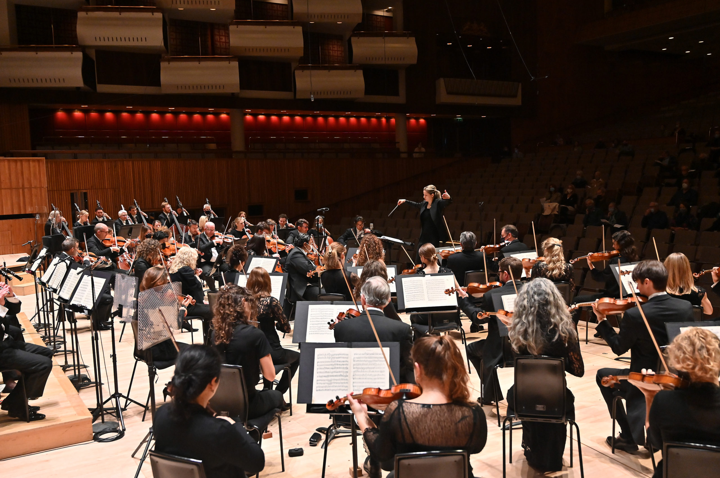
GCSE BrightSparks
Resources
BrightSparks is generously funded by the Rothschild Foundation with additional support from the Candide Trust, Dunard Fund, Rivers Foundation, Mr & Mrs Philip Kan, Gill and Julian Simmonds
© Rachel Leach and the London Philharmonic Orchestra 2023

Slide 2
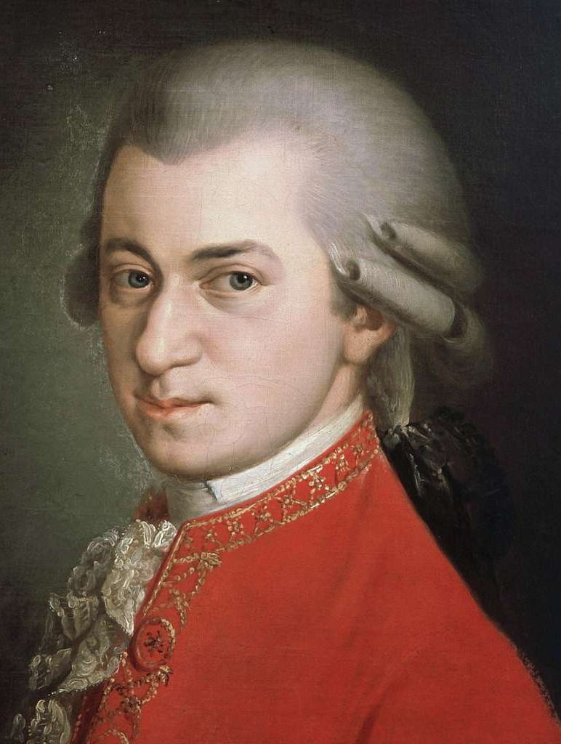
Wolfgang Amadeus Mozart
(1756–1791)
Horn Concerto No. 4
Third Movement:
Rondo
(1786)

Slide 3

What is a concerto?
In the Baroque period (c.1650–1750), there were two main types of concerto:
  Solo concerto = one soloist and orchestra
  Concerto grosso = small group of soloists (concertino) and accompanying group (ripieno)
In the Classical period (c.1750–1820), the solo concerto became prominent, and was usually made up of three movements:
  First movement – fast
  Second movement – slow
  Third movement – fast

Slide 4
Wolfgang Amadeus Mozart
(1756–1791)
Mozart is one of the most prolific and influential composers of the Classical period
He was well-known for his concertos, and his clarinet concerto is considered by many to be one of his best works. He also wrote concertos for piano, violin, flute and oboe, among other instruments

Slide 5
Wolfgang Amadeus Mozart
(1756–1791)
Learn more about the French Horn and Mozart’s Horn Concerto No. 4:
https://youtu.be/BPN34ke1aMM

Slide 6
What is Rondo form?
The third movement of Mozart’s Horn Concerto No. 4 is in Rondo form
Rondo is Italian for ‘round’
Rondo is a musical shape with one recurring idea (idea ‘A’)
The structure is therefore A-B-A-C-A-D-A etc.
The interspersed sections are called episodes
Let’s explore the recurring theme ‘A’ from the third movement of Mozart’s Horn Concerto…

Slide 7
Theme A (bars 1–8)
This very famous theme has a fanfare-like sound
It starts on the upbeat (anacrusis) and it contains repeated pitches and the outline of a triad
The key is Eb major and the harmony begins in Eb, moves to Bb (chord V) halfway through and back to Eb at the end
The theme is first played by the horn accompanied by detached chords from the strings, then it’s immediately repeated by orchestra with louder dynamics

Slide 8
Theme A (bars 17–28)
This theme uses both triads and scales
At bar 24 there are parallel thirds in the violins and violas, using a descending sequence (sequence means the same material repeated on a different starting pitch)

Slide 9
Theme A (bars 28–36)
We are now in the dominant key
This phrase is imitated by the violins
Then we have four bars in F, which is the dominant of Bb, so the dominant of the dominant
The horn’s motif is based on bar 3, and we hear it both ‘the right way up’ and inverted twice

Slide 10
Theme A (bars 36–38)
There is a descending sequence from the orchestra
This takes us to the dominant key of Bb and the first episode

Slide 11
First episode (bars 38–67)
After Theme A we hear the first episode
The solo horn introduces new material accompanied by sustained string chords
We are in the dominant key (Bb)
Violins imitate while the horn adds a countermelody (a second melody)
At bar 46 four detached chords are answered by a rising arpeggio and falling scale from the horn
The chords then repeat and are answered by an extended reply from the solo horn
At bar 60, several devices are combined – there is an 8 bar dominant pedal in the lower strings, an ascending sequence in the upper strings, and a descending chromatic scale in the horn which takes us back to Theme A

Slide 12
Theme A (bars 68–83)
Theme A returns in the solo horn followed by the orchestra, as before

Slide 13
Second episode (bars 84–120)
In bar 84, three repeated notes announce the second episode
The first phrase is in C minor, and the second phrase is in Ab major
Mozart uses material from earlier but in a new key (Ab major)
In bar 114, perfect cadences and a descending sequence take us back to the home key and Theme A

Slide 14
Theme A (bars 121–152)
Theme A returns in the solo horn followed by the orchestra, as before
In bar 137 the second phrase of the rondo repeats but this time turns minor before modulating to the dominant
We then hear a repeat of bars 32-37 but this time in Bb major, ready for the third episode

Slide 15
Third episode (bars 153–178)
The same as the first episode but now in the tonic key (Eb major)
A hunting horn fanfare is added
Bar 161 is a repeat of bar 46
There is a pause on the dominant 7th for the cadenza, a short improvised section by the soloist

Slide 16
Theme A (bars 179–204)
Theme A returns
The solo horn introduces the melody as before
The orchestral repeat is extended and returns to the home key
There are two perfect cadences
At bar 198 a segment of the rondo theme is repeated with different harmony and an interrupted cadence (Chord V-VI), then a perfect cadence

Slide 17
Coda (bars 205–end)
The coda is the ending section of the piece, which re-establishes the home key
Features alternating tonic and dominant harmony over a tonic pedal (a long note underpinning the texture and harmony)
Soloist plays arpeggios which show the full range of the instrument

